Slide 1








Lesson 1. Angular 4 Route Parameters

Slide 2
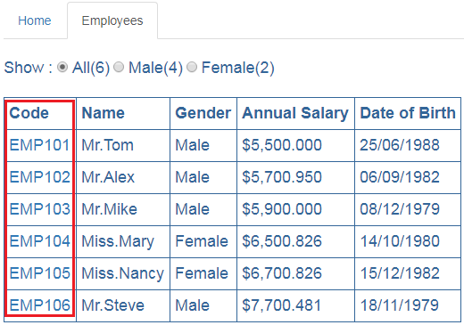
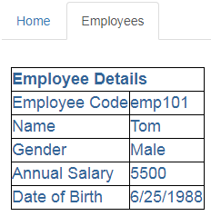
Angular 4 Route Parameters
http://localhost/employees/emp101

Slide 3
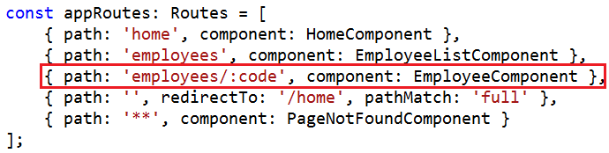
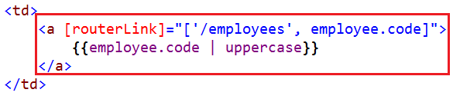

Angular 4 Route Parameters
Step 1 : Create the route with a parameter
Step 2 : Bind to the route using [routerLink] directive. In the binding we are using link parameters array
The first element in the array is the path of the route to the destination component
The second element in the array is the route parameter value, in our case the employee code

Slide 4
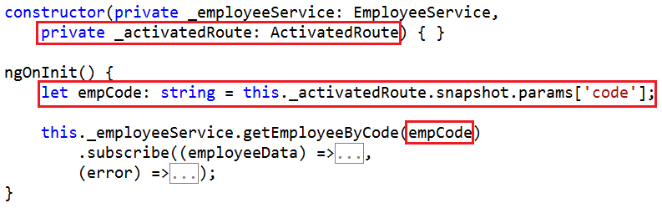
Angular 4 Route Parameters
Step 3 : Use the ActivatedRoute service to retrieve the parameter value from the URL

Slide 5
Q & A
Contact:rashmipawaskar@synergetics-india.com

Slide 6
Thank You

